Slide 1
Improving Prescribers’ HPV Vaccine Communication
Tips for IQIP consultants
Training funded by the Centers for Disease Control and Prevention
Developed by hpvIQ.org
© 2020, The University of North Carolina at Chapel Hill. All rights reserved.

Slide 2
Overview

Slide 3
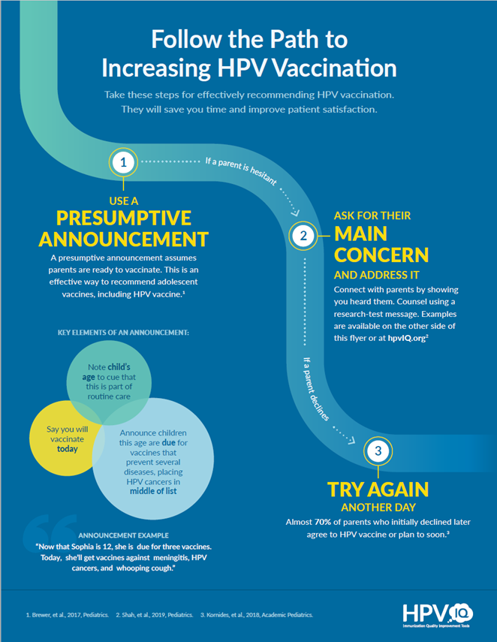
A resource for IQIP consultants
This slide set is for training IQIP consultants to help prescribers give strong HPV vaccine recommendations
The accompanying flyer should be shared with clinic
representative and prescribers
These materials are also available at hpvIQ.org
© 2020, The University of North Carolina at Chapel Hill. All rights reserved.

Slide 4
A complex game of telephone
The ideas from an IQIP visit may go through intermediaries
The message can get garbled—or lost —at any point
To get the message to prescribers, sharing clear and simple tools is critical
IQIP Coordinator
IQIP Consultant
Clinic Rep
Prescriber
Family
© 2020, The University of North Carolina at Chapel Hill. All rights reserved.

Slide 5

How to use these slides
The left half of each slide shows IQIP consultants how to motivate prescribers and improve their communication skills
These are based on our experience leading hundreds of communication trainings
The right half of each slide gives tools and facts for answering questions during IQIP visits
These are adapted from the Announcement Approach Training, a research-tested strategy
© 2020, The University of North Carolina at Chapel Hill. All rights reserved.

Slide 6
Motivating prescribers

Slide 7
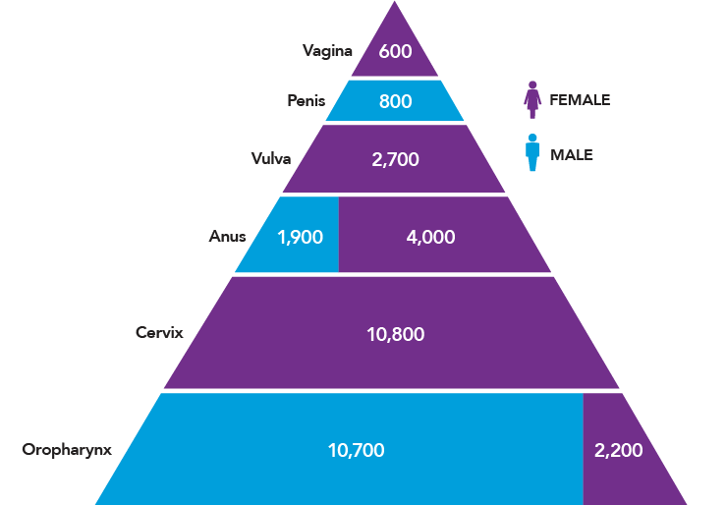
HPV vaccination matters
HPV causes 6 cancers
Prescribers need to know HPV vaccine matters for adolescents
Many don’t know that HPV causes 6 cancers, over 34,000 every year
Consider sharing a brief video of someone affected by HPV cancer
Library of relevant videos
President’s Cancer Panel Annual Report, 2018, slide courtesy of Dr. Brewer
© 2020, The University of North Carolina at Chapel Hill. All rights reserved.

Slide 8
HPV vaccination works
In our experience, most prescribers believe HPV vaccine is effective
Even so, they are often surprised by how large an impact it is already having in preventing precancers
Effectiveness
A study of 1.6 million women found that HPV vaccination before age 17 reduced cervical cancer incidence by 90%
Lei, et al., 2020, NEJM
© 2020, The University of North Carolina at Chapel Hill. All rights reserved.
Notes:
ORIGINAL

Slide 9
HPV vaccination is safe
Most trainings have at least one question we can’t answer, usually about a rare safety concern
Answer the question if you can
For the rest, say you will get back to them, and follow through
CDC has the answers to these questions
Safety
109 studies have looked at 2.5 million people in 6 countries
No serious adverse events beyond what is typical for other teen vaccines (such as fainting)
Phillips, et al., 2017, Drug Safety
© 2020, The University of North Carolina at Chapel Hill. All rights reserved.

Slide 10
Prescriber recommendations matter
You can help prescribers understand the large impact of their recommendation
Prescriber recommendations are more powerful than
Parents’ vaccination beliefs
Ethnicity
Education
Impact
Prescriber recommendations have a big impact on HPV vaccination coverage
47% vaccinated with no recommendation
75% vaccinated with a recommendation
National Immunization Survey—Teen, 2019. Elam-Evans, et al., 2019, MMWR
© 2020, The University of North Carolina at Chapel Hill. All rights reserved.

Slide 11
Skills building

Slide 12

Share steps for effective communication
The flyer on the right includes the steps from the Announcement Approach to recommending adolescent vaccination
This approach
Saves time for prescribers
Increases patient and prescriber satisfaction
Increases vaccine uptake
Brewer, et al., 2017, Pediatrics. Malo, et al., 2018, Implementation Science.
© 2020, The University of North Carolina at Chapel Hill. All rights reserved.

Slide 13
Step 1. Use a presumptive announcement
A presumptive announcement assumes a family is ready to vaccinate
The prescriber should treat HPV vaccine just like the others they have provided
Focus on diseases, not vaccines
Put HPV cancers in the middle of the list to normalize HPV vaccine and focus on cancer prevention
Emphasize same-day vaccination
© 2020, The University of North Carolina at Chapel Hill. All rights reserved.

Slide 14
How to give a presumptive announcement
Note child’s age
Announce children this age are due for vaccines that prevent several diseases, placing HPV cancers in middle of list
Say you will vaccinate today
Now that Sophia is 11, she’s due for 3 vaccines to protect against meningitis, HPV cancers, and pertussis. We’ll give them at the end of the visit.
Slide adapted from the Announcement Approach Training, courtesy of Dr. Brewer
© 2020, The University of North Carolina at Chapel Hill. All rights reserved.

Slide 15
If a parent is hesitant... Step 2. Ask for their main concern
Some parents will have questions
But hesitancy doesn’t mean no
Ask what their main concern is
Use a research-tested message to address hesitant parents
© 2020, The University of North Carolina at Chapel Hill. All rights reserved.

Slide 16
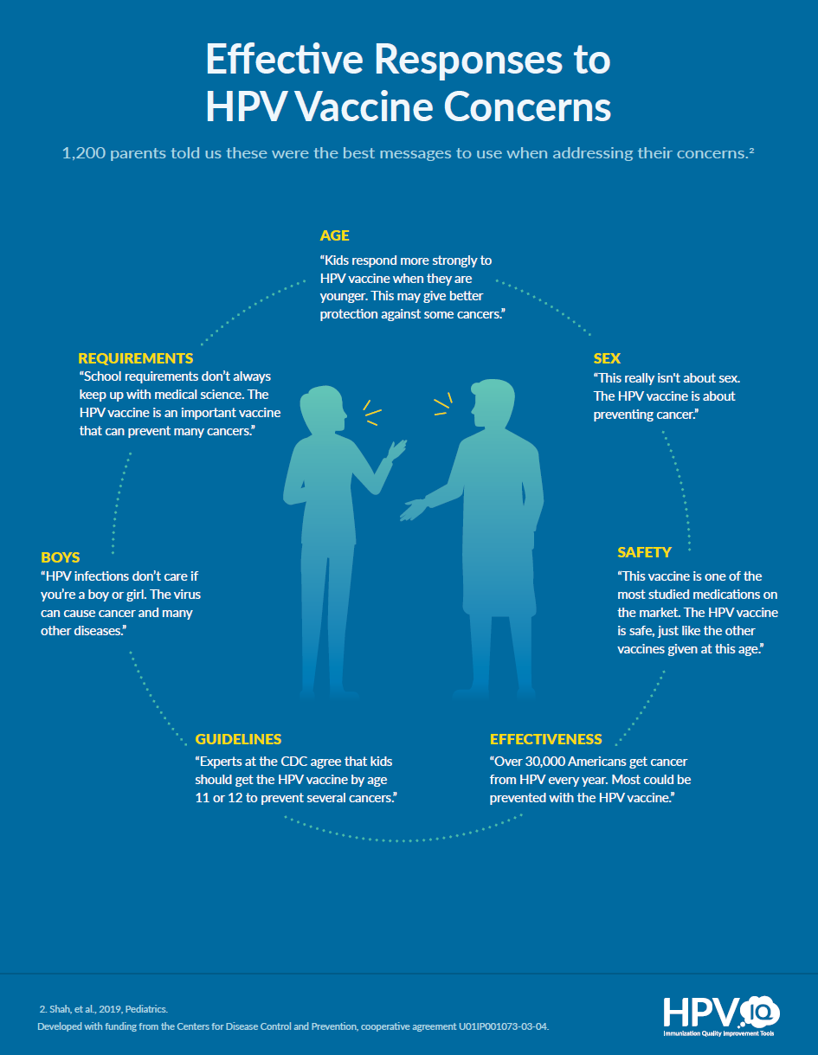
Use research-tested messages for hesitant parents
The messages were tested in research with ~1,200 parents
These messages are short so you can remember the main points
Build on these based on what you know about HPV vaccination
Shah, et al., 2019, Pediatrics
© 2020, The University of North Carolina at Chapel Hill. All rights reserved.

Slide 17
If you hear “no”… Step 3. Try again another day
Almost 70% of parents who initially declined later consent to HPV vaccination
45% report getting HPV vaccine at a later visit
24% plan to in the next year
A recommendation at a follow-up visit increases vaccination
Survey of 494 parents of US adolescents. Kornides, et al., 2018, Academic Pediatrics
© 2020, The University of North Carolina at Chapel Hill. All rights reserved.

Slide 18
The Announcement Approach Training

Slide 19


The Announcement Approach Training
A 1-hour training is available for vaccine prescribers
In-clinic or live webinar
Sections of the training
Review evidence on HPV vaccination
Build skills to use the approach
Demonstration and practice
Training slides and scripts are available at hpvIQ.org
© 2020, The University of North Carolina at Chapel Hill. All rights reserved.

